Slide 1
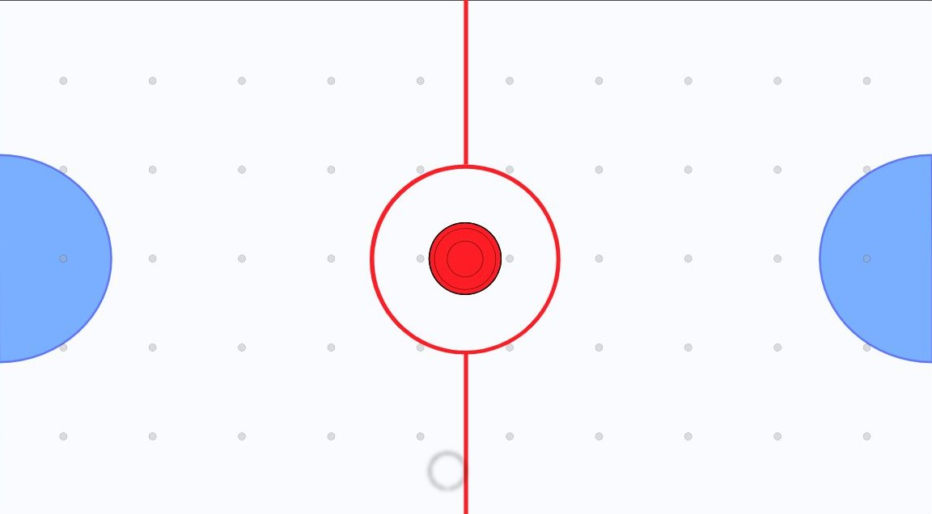
mbed Air Hockey
ECE 4180, Fall 2018
Carlos Menendez, Noah Roberts, Arjun Sabnis

Slide 2
Project Overview
We developed a virtual Air Hockey game using the following:
Kinematics engine to simulate the game physics.
An IMU and speaker connected to an mbed controller.
A node server on a Raspberry Pi Zero W to implement the game engine and graphics.

Slide 3
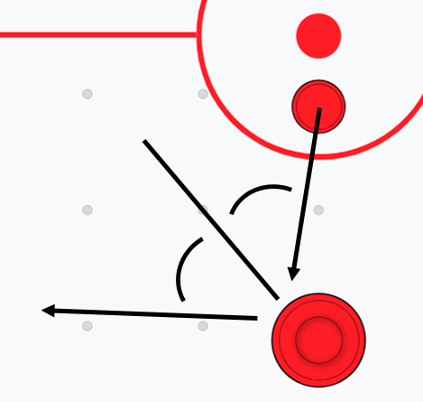
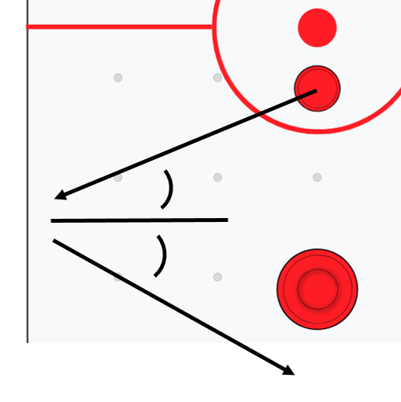
Kinematics
Update position:
Numerical velocity integration ➔ pNew = pOld + v*Δt
Collisions:
Puck collision with Striker
Puck collision with Border

Slide 4
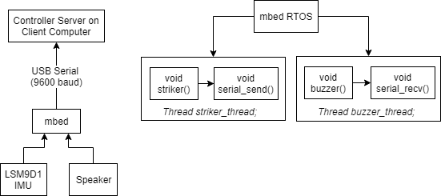
mbed Striker Controller
Hardware Layout
Software Flow
Single packet send/receive over Serial
Small hardware footprint

Slide 5
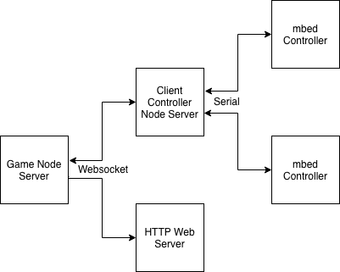
Game Server and Networking
Modular
Scalable

Slide 6
Future Work
The game is easily scalable
Host game server on global IP
Create multiple higher-end controllers in mass
Create a match-making system so people from all over the world can play with each other
The current kinematics are limited
Implement with higher-power hardware to boost smoothness
Further take advantage of the faster hardware by applying more robust kinematics
Controller is low-power and has minimal hardware
Implement with more streamlined design, fewer components
Code can be better optimized to reduce calculations and use serial interrupts

